Slide 1
Sparse MRI:
The Application of Compresses Sensing for Rapid MR Imaging

Slide 2
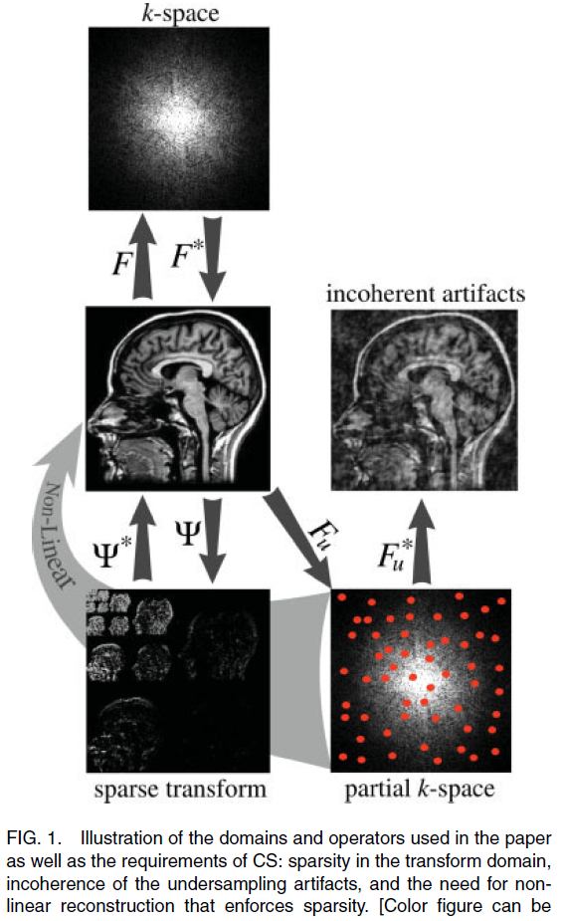
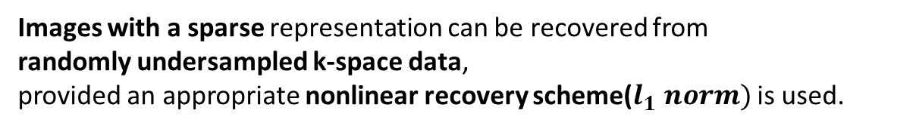
Sparse MRI : The Application of Compressed Sensing for Rapid MR Imaging
The sparsity is implicit in MR images.
- Angiograms(pixel domain),
- Spatial finite-differences, wavelet coefficients
Images with a sparse representation can be recovered from
randomly undersampled k-space data,
provided an appropriate nonlinear recovery scheme($l_{1} norm)$ is used.

Slide 3
1. Introduction
2. Theory
2.1. Compressed Sensing
2.2. Sparsity
2.3. Incoherent Sampling
2.4. Point Spread Function and Transform Point Spread Function Analysis
2.5. Single-slice 2DFT, multi-slice 2DFT, and 3DFT Imaging
2.6. Variable Density Random Undersampling
2.7. How Many Samples to Acquire?
2.8. Monte-Carlo Incoherent Sampling Design
2.9. Image Reconstruction
2.10. Low-Order Phase Correction and Phase Constrained Partial k-space
3. Discussion
3.1. Reconstruction Artifacts
Appendix
A. Nonlinear Conjugate-Gradient Solution of The CS Optimization Procedure

Slide 4
1.
Introduction
Sparsity : most transform coefficients are negligible and relatively few values with nonzero values are crucial.
Since the images we intend to acquire will be compressible, with a few significant coefficients, is it really necessary to acquire all that data in the first place?
Can we simply measure the compressed information, and reconstruct the same image like the fully sampled one?
Furthermore, since MRI measures Fourier coefficients, the question is whether it is possible to do the above by measuring only a subset of k-space?

Slide 5
1. Introduction
The data acquisition speed of MRI is circumscribed by physical(gradient amp) and physiological(nerve stimulation) constraints. Therefore, many researches are seeking for methods to reduce the amount of acquired data without degrading the image quality.
Proposed methods to mitigate undersampling artifacts are
1) Generating artifacts that are incoherent or less visually apparent, at the expense of SNR
2) Exploiting redundancy in k-space, such as partial-Fourier, parallel imaging
3) Exploiting either spatial or temporal redundancy or both
In this article we aim to exploit the implicit sparsity in MR images(transform sparsity) and develop an approach combining 1) and 2) methods(SNR trade off and k-space redundancy).
Ex. The identity transform
-> the transform domain is simply the image domain itself.
-> For example, angiograms are extremely sparse in the pixel representation.
Ex. More complex medical images
-> may not be sparse in the pixel representation
-> but they do exhibit transform sparsity, since they have a sparse representation in terms of spatial finite differences, in terms of their wavelet coefficients, or
in terms of other transforms.

Slide 6
In mathematics, the support of a real-valued function f is the subset of the domain containing those elements which are not mapped to zero.
1. Introduction
Sparsity is a constraint, generalizing the notion of finite object support.
It is well understood why support constraints in image space (i.e., small FOV or band-pass sampling) enable sparser sampling of k-space.
Sparsity constraints are more general because nonzero coefficients do not have to be bunched together in a specified region.
Transform sparsity is even more general because the sparsity needs only to be evident in some transform domain.
Sparsity constraints, under the right circumstances, can enable sparser sampling of k-space as well.

Slide 7
1. Introduction
If the image exhibits transform sparsity, and if k-space undersampling results in incoherent artifacts in that transform domain, then the image can be recovered from randomly undersampled frequency domain data with an appropriate nonlinear recovery scheme.
In this article we aim to develop a framework for using CS in MRI especially on Cartesian sampling.

Slide 8
2.
Theory

Slide 9
2.1. Compressed Sensing
Compressed Sensing(CS) :
Measuring a small number of random linear combinations of the signal values and accurately
Reconstructing these measurements by a non linear procedure.
In MRI,
the sampled linear combinations are simply individual Fourier coefficients (k-space samples).
In that setting, CS makes accurate reconstructions from a small subset of k-space.

Slide 10
2.1. Compressed Sensing
The CS approach requirements :
(a) the desired image have a sparse representation
in a known transform domain (i.e., is compressible).
(b) the aliasing artifacts due to k-space undersampling
be incoherent (noise like) in that transform domain.
(c) a nonlinear reconstruction be used to enforce
both sparsity of the image representation and
consistency with the acquired data.

Slide 11
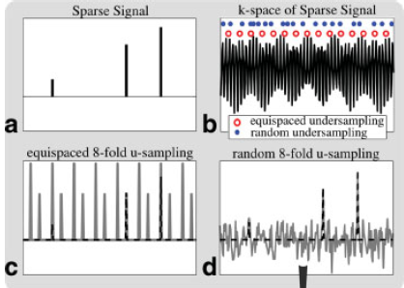
2.1. Compressed Sensing
The importance of incoherence
Example. (the sparse transform is simply the identity)
The reconstruction data from equispaced k-space undersampling shows coherent aliasing(a superposition of shifted replicas of the signal).
In this case, there is an inherent ambiguity; it is not possible to distinguish between the original signal and its replicas, as they are all equally likely.

Slide 12
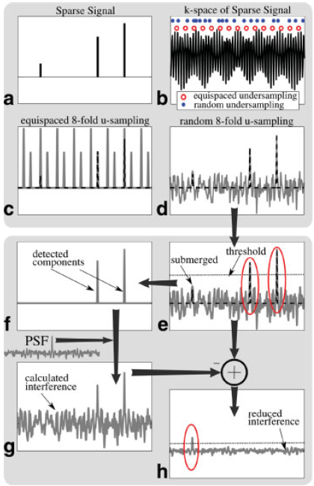
2.1. Compressed Sensing
Random undersampling exhibits incoherent artifacts that actually behave much like additive random noise. (These artifacts are not noise; rather, the energy leakage from original signal.)
If all the underlying original signal coefficients are known,
this leakage can be calculated analytically by multiplying PSF.
By thresholding, recovering the strong components, and calculating the interference caused by them and subtracting it.
Subtracting the interference of the strong components reduces the total interference level and enables recovery of weaker, submerged components.
By iteratively repeating this procedure, one can recover the rest of the signal components.

Slide 13
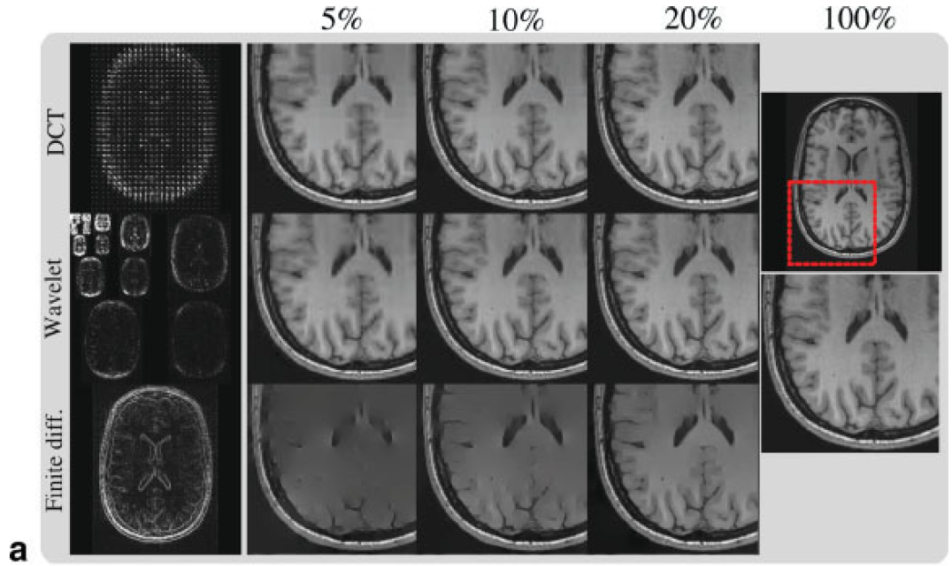
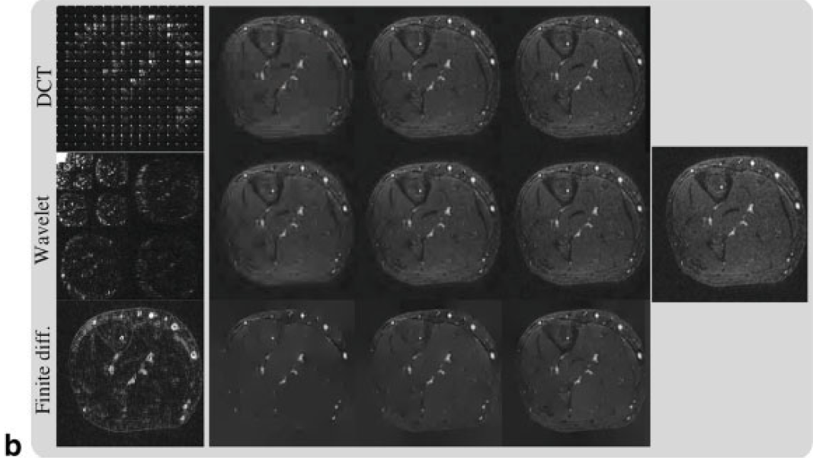
2.2. Sparsity
A sparsifying transform :
an operator mapping a vector of image data to a sparse vector.
For example,
Spatial finite-differences (i.e, computing the differences between neighboring pixels)
-> Since computing finite-differences of images is a highpass filtering operation, the finite- differences transform can also be considered as computing some sort of fine-scale wavelet transform (without computing coarser scales).
Discrete cosine transform(DCT) and Wavelet transform
-> Natural, real-life images are known to be sparse in these transform domains.

Slide 14
2.3. Incoherent Sampling
Incoherent aliasing interference in the sparse transform domain is an essential ingredient for CS.
Random point k-space sampling in all dimensions is generally impractical physiologically and hardware-ly.
Instead, we aim to design a practical incoherent sampling scheme that mimics the interference
properties of pure random undersampling as closely as possible yet allows rapid collection of data.
Here, we consider only the case of Cartesian grid sampling where the sampling is restricted to undersampling the phase-encodes and fully sampled readouts.
Cartesian sampling is simple and
also highly robust to numerous sources of imperfection.

Slide 15
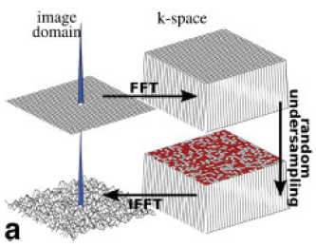

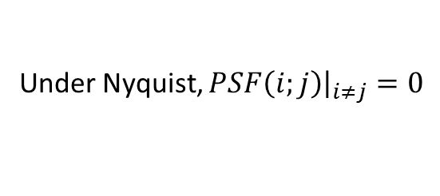

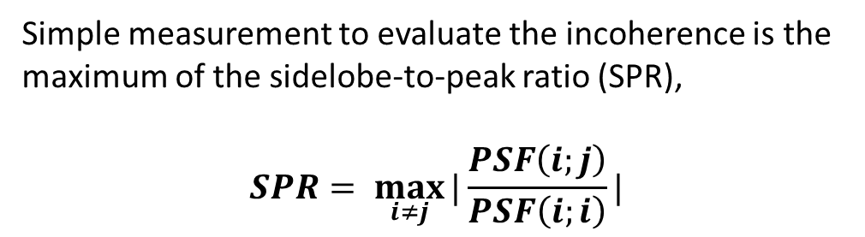

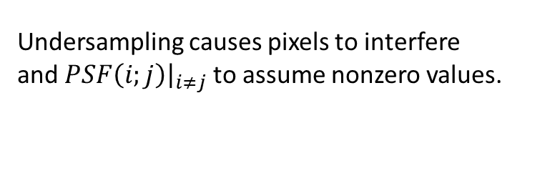

2.4. Point Spread Function and Transform Point Spread Function Analysis
Let $F_{u}$ be the undersampled Fourier operator and let $e_{i}$ be the i-th vector of the natural basis
(i.e, having “1” at the ith location and zeroes elsewhere).
Then, $PSF\left(i;j\right)=e_{j}^{∗}F_{u}^{∗}F_{u}e_{i}$ measures the j-th position’s intensity from the energy leakage of the i-th image pixel.
Under Nyquist, $PSF\left(i;j\right){\left.​\right|}_{i≠j}=0$
Undersampling causes pixels to interfere
and $PSF\left(i;j\right){\left.​\right|}_{i≠j}$to assume nonzero values.
$$e_{i}$$
$${Fe}_{i}$$
Simple measurement to evaluate the incoherence is the maximum of the sidelobe-to-peak ratio (SPR),
$$SPR= \max_{i≠j}{|\frac{PSF\left(i;j\right)}{PSF\left(i;i\right)}|}$$
$${F_{u}e}_{i}$$
$${{F_{u}^{∗}F}_{u}e}_{i}$$

Slide 16
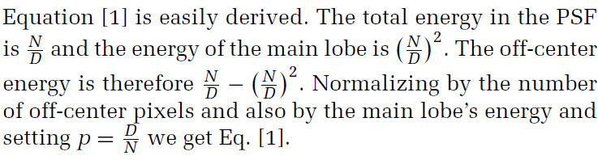
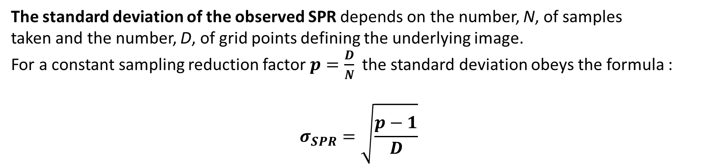

2.4. Point Spread Function and Transform Point Spread Function Analysis
Empirically, the real and the imaginary parts separately behave much like zero-mean
random white Gaussian noise.
The standard deviation of the observed SPR depends on the number, N, of samples
taken and the number, D, of grid points defining the underlying image.
For a constant sampling reduction factor $p=\frac{D}{N}$ the standard deviation obeys the formula :
$$σ_{SPR}=\sqrt{\frac{p−1}{D}}$$
$$off−centre E : \frac{\frac{N}{D}−{\left(\frac{N}{D}\right)}^{2}}{D{\left(\frac{N}{D}\right)}^{2}}=\frac{\frac{D}{N}−1}{D}=\frac{p−1}{D}$$
$$deviation=sqrt\left(E\right)=sqrt(\frac{p−1}{D})$$
$$D :the \# of off−center pixels(=D−1≈D)$$
$${\left(\frac{N}{D}\right)}^{2}:the main lobe^{′}s energy$$

Slide 17
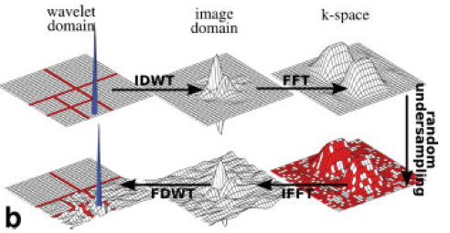






2.4. Point Spread Function and Transform Point Spread Function Analysis
The MR images are sparse in a transform domain. In such a setting, incoherence is analyzed by Transform Point Spread Function (TPSF) which is generalizing version of PSF. It measures how a single transform coefficient of the underlying object ends up influencing other transform coefficients of the measured undersampled object.
Let be an orthogonal sparsifying transform. The TPSF(i; j) is :
$$TPSF\left(i;j\right)=e_{j}^{∗}ψF_{u}^{∗}F_{u}ψ^{∗}e_{i}$$
Ex. $ψ=orthogonal wavelet transform$
$$e_{i}$$
$$ψ^{∗}e_{i}$$
$$Fψ^{∗}e_{i}$$
In words, a single point in the transform space at the i-th
location is transformed to the image space and then to the
Fourier space.
The Fourier space is subjected to undersampling, then transformed back to the image space.
Finally, a return is made to the transform domain and the j-th location of the result is selected.
$$F_{u}ψ^{∗}e_{i}$$
$$ψF_{u}^{∗}F_{u}ψ^{∗}e_{i}$$
$$F_{u}^{∗}F_{u}ψ^{∗}e_{i}$$

Slide 18
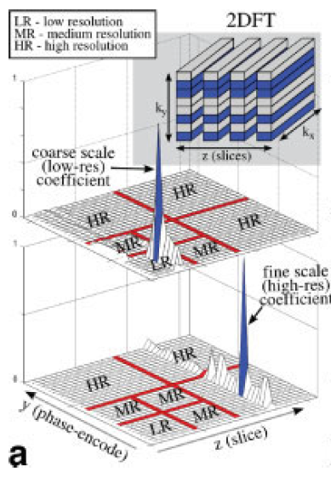
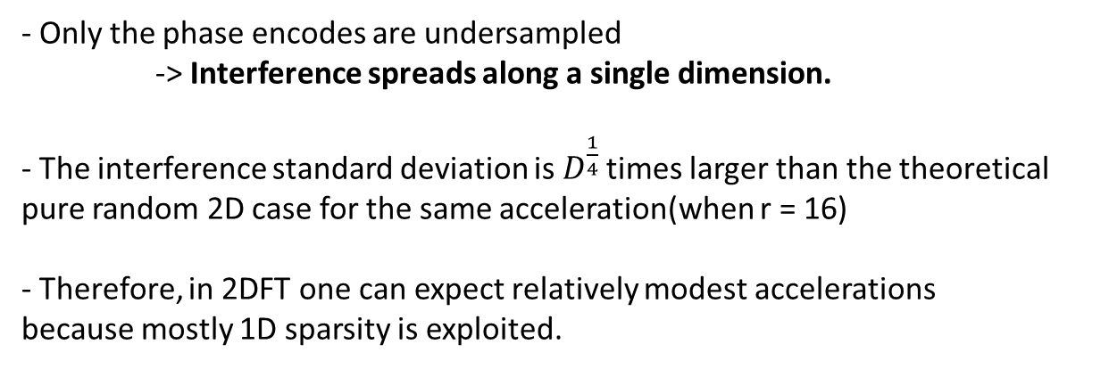
2.5. Single-slice 2DFT, multi-slice 2DFT, and 3DFT Imaging
Single-slice 2DFT
- Only the phase encodes are undersampled
-> Interference spreads along a single dimension.
- The interference standard deviation is $D^{\frac{1}{4}}$ times larger than the theoretical pure random 2D case for the same acceleration(when r = 16)
- Therefore, in 2DFT one can expect relatively modest accelerations
because mostly 1D sparsity is exploited.

Slide 19
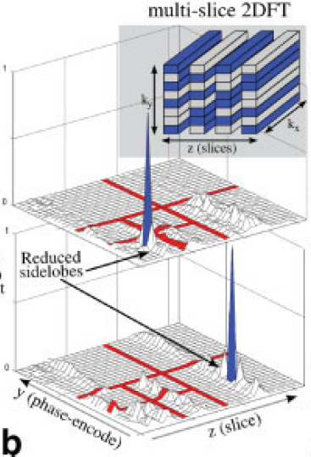
2.5. Single-slice 2DFT, multi-slice 2DFT, and 3DFT Imaging
Multi-slice 2DFT
- The phase-encodes of each slice randomly undersampled($k_{y}−z$ space).
- This can reduce the peak sidelobe in the TPSF, but is not as effective as random undersampling in a pure 2D k-space(Fig. 5c).
- It will work particularly well when the slices are thin and finely spaced. When the slices are thick and with gaps, there is little spatial redundancy in the slice direction and the performance of the reconstruction would be reduced to the single-slice 2DFT case.

Slide 20
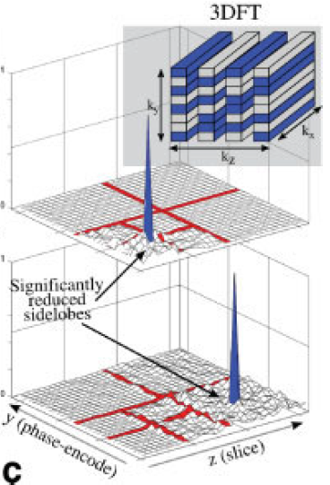
2.5. Single-slice 2DFT, multi-slice 2DFT, and 3DFT Imaging
3DFT
- Three-dimensional imaging is particularly attractive because it is often time consuming and scan time reduction is a higher priority than 2D imaging.
- The peak interference of the wavelet coefficients is significantly reduced compared to multislice and plain 2DFT undersampling.

Slide 21
2.6. Variable Density Random Undersampling
Representations of natural images exhibit a variety of significant nonrandom structures.
- Most of the energy of images is concentrated close to the k-space origin.
=> one should be undersampling less near the k-space origin and more in the periphery of k-space.
For example, one may choose samples randomly with sampling density scaling according to a power of distance from the origin. Empirically, using density powers of 1–6 yields better reconstruction.
2.7. How Many Samples to Acquire?
The number of Fourier sample points is collected with respect to the number of sparse coefficients
In practice, for a good reconstruction, the number of k-space samples should be roughly two to five times the number of sparse coefficients

Slide 22
2.8. Monte-Carlo Incoherent Sampling Design
Finding an optimal sampling scheme that maximizes the incoherence for a given number of samples is a combinatorial optimization problem and might be considered intractable.
So, we propose the following Monte-Carlo design procedure:
1) Choose a grid size based on the desired resolution and FOV of the object.
2) Undersample the grid by constructing a probability density function (pdf) and randomly draw indices from that density. Variable density sampling of k-space is controlled by the pdf construction. A plausible choice is diminishing density according to a power of distance from the origin as previously discussed.
3) Repeat the procedure many times, because the procedure is random, one might accidentally choose a sampling pattern with a “bad” TPSF.
4) Finally, choose the pattern with the lowest peak interference.
5) Once a sampling pattern is determined it can be used again for future scans.

Slide 23
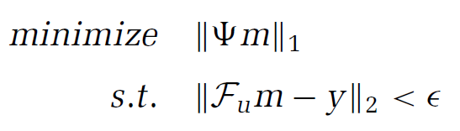
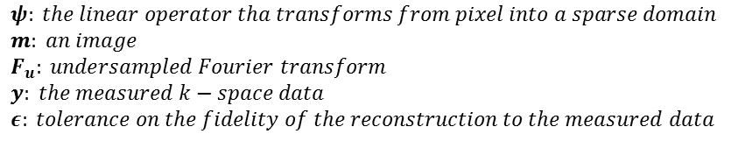
2.9. Image Reconstruction
The processes of nonlinear image reconstruction appropriate to the CS setting.
$ψ: the linear operator tha transforms from pixel into a sparse domain$
$m: an image$
$F_{u}: undersampled Fourier transform$
$y: the measured k−space data$
$ε: tolerance on the fidelity of the reconstruction to the measured data$
Minimizing ${\left|\left|ψm\right|\right|}_{1}$ promotes sparsity and the constraint ${\left|\left|F_{u}m−y\right|\right|}_{2}<ε$ enforces data consistency.
In words, among all solutions which are consistent with the acquired data, Eq. [3] finds a solution which
is compressible by the transform .

Slide 24
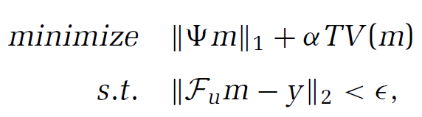
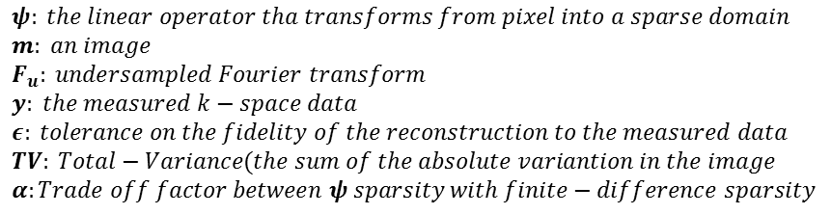
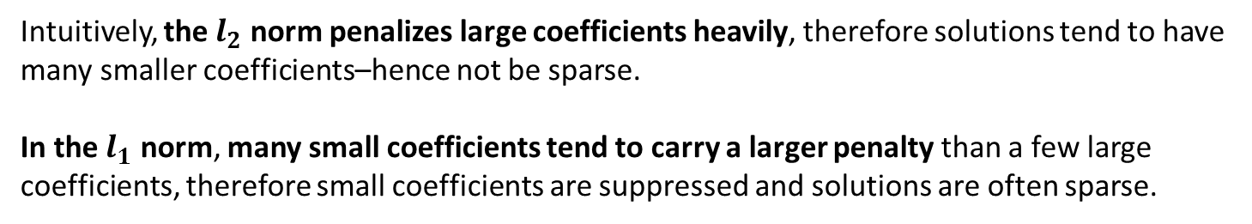
2.9. Image Reconstruction
Requiring the image to be sparse by both the specific transform and finite-differences at the same time.
$ψ: the linear operator tha transforms from pixel into a sparse domain$
$m: an image$
$F_{u}: undersampled Fourier transform$
$y: the measured k−space data$
$ε: tolerance on the fidelity of the reconstruction to the measured data$
$TV: Total−Variance(the sum of the absolute variantion in the image$
$α:Trade off factor between ψ sparsity with finite−difference sparsity$
Minimizing the $l_{2}$ norm does not result in a sparse solution.
Intuitively, the $l_{2}$ norm penalizes large coefficients heavily, therefore solutions tend to have many smaller coefficients–hence not be sparse.
In the $l_{1}$ norm, many small coefficients tend to carry a larger penalty than a few large coefficients, therefore small coefficients are suppressed and solutions are often sparse.

Slide 25
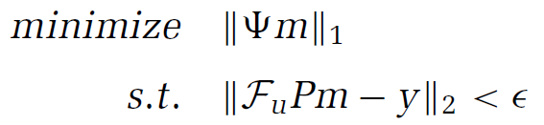
2.10. Low-Order Phase Correction and Phase Constrained Partial k-space
In MRI, instrumental sources of phase errors can cause low-order phase variation.
These create artificial variation in the image which
makes it more difficult to sparsify, especially by finite differences.
By estimating the phase variation, the reconstruction can be significantly improved.
This phase estimate may be obtained using very low-resolution fully sampled k-space information.
Alternatively, the phase is obtained by solving Eq. [3] to estimate the low-order phase, and
repeating the reconstruction while correcting for the phase estimate.
where P is a diagonal matrix whose entries give the
estimated phase of each pixel.

Slide 26
3.
Discussion

Slide 27
3. . Reconstruction Artifacts
The $l_{1}$ reconstruction tends to slightly shrink the magnitude of the reconstructed sparse coefficient.
It can be relieved by using smaller $ε$(data consistency parameter)
In some wavelet-based CS reconstructions, small high-frequency oscillatory artifacts may appear in the reconstruction.
This is because of false detection of fine-scale wavelet components.
This artifacts can be mitigated by adding small TV penalty.
This can be considered as requiring the image to be sparse in both wavelet and finite-differences transforms.

Slide 28
Appendix

Slide 29
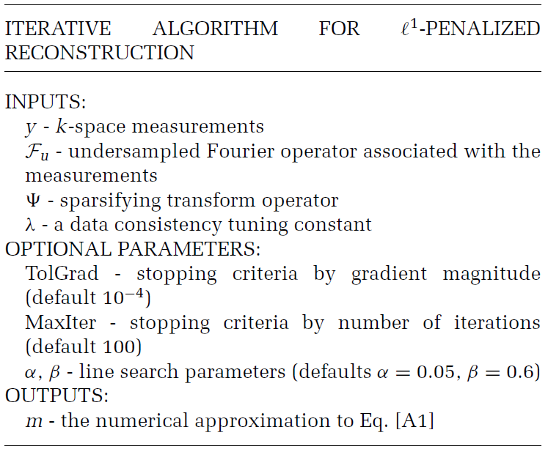
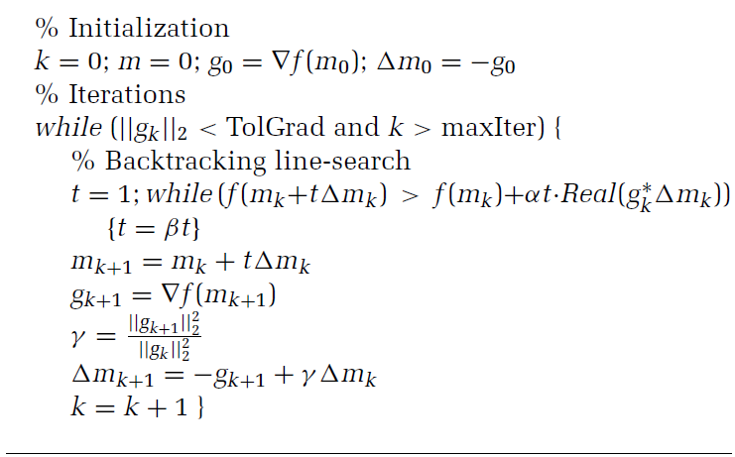
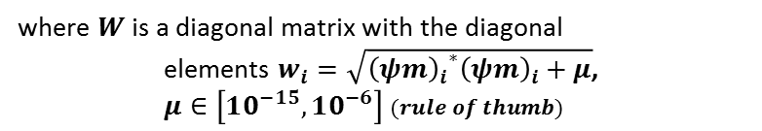
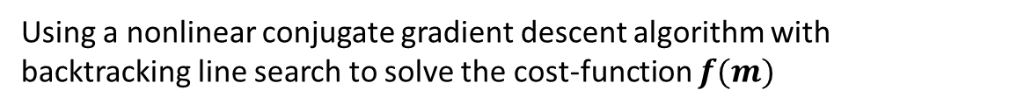



A. Nonlinear Conjugate-Gradient Solution of The CS Optimization Procedure
Consider the unconstrained Lagrangian form.
$$f\left(m\right)=$$
$$λ :regularization parameter$$
Using a nonlinear conjugate gradient descent algorithm with backtracking line search to solve the cost-function $f(m)$
Approximate the $l_{1}$ differential using $|x|≈\sqrt{x^{∗}x+μ}$, $\frac{d\left|x\right|}{dx}≈\frac{x}{\sqrt{x∗x+μ}}$
$$μ :a positive smoothing parameter$$
where $W$ is a diagonal matrix with the diagonal
elements $w_{i}=\sqrt{{{\left(ψm\right)}_{i}}^{∗}{\left(ψm\right)}_{i}+μ}$,
$μ∈\left[10^{−15},10^{−6}\right] (rule of thumb)$

Slide 30
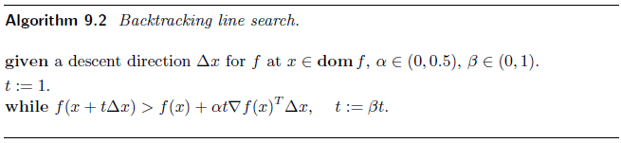
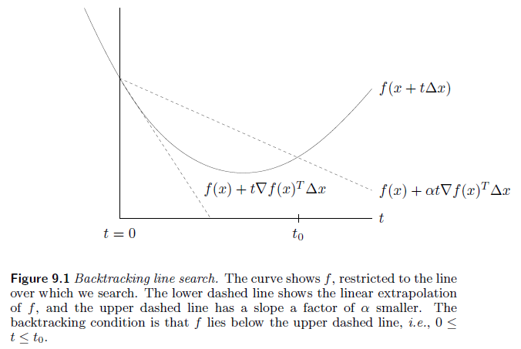
A. Nonlinear Conjugate-Gradient Solution of The CS Optimization Procedure
Backtracking line search
the step length(t) is chosen to approximately($β^{n}t$) along search direction($∆x$) and a slope factor($α$)
minimize ‘f’ along the ray {x + tx | t ≥ 0}, or even to just reduce f ‘enough’.

Slide 31
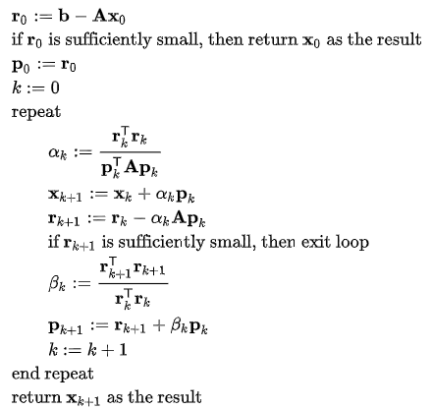
A. Nonlinear Conjugate-Gradient Solution of The CS Optimization Procedure
Conjugate gradient
$β :$factor using for update next search direction

